Slide 1
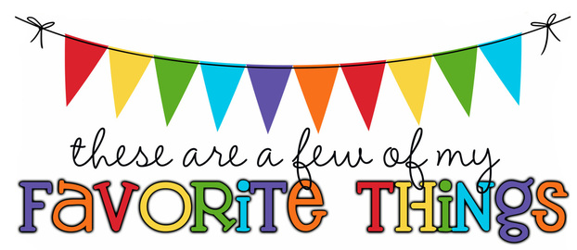
Monogram: JRP Birthday: August 2 Shoe Size: 7 Food & Candy: fruits – bananas, grapes, berries – Hershey’s with almonds Color: purple, teal, hot pink, royal blue Drink: water, Pellegrino and bubbly sparkling waters Flower: tulips, peonies, hydrangeas and lilacs Scent (lotion): vanilla Starbucks Drink: none – I don’t go to Starbucks or Dunkin Restaurants: BJs, Bahama Breeze, Cheesecake Factory Sports Team: KC Chiefs, KC Royals Stores: Publix, Amazon, Walmart, Author: I’m wanting to read Jenny Han’s series, The Summer I Turned Pretty Hobbies: traveling, gardening Items I need for the classroom: treasure box items (candies, chips, small toys (pop its)

