Slide 1
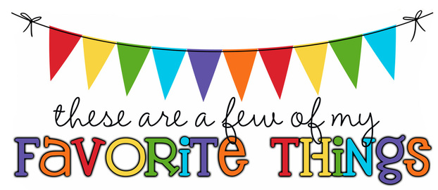
Monogram: JRP Birthday: August 2 Shoe Size: 7/7.5 Food & Candy: no candy, fruits – bananas, grapes, berries Color: purple and teal Drink: water, Pellegrino and bubbly sparkling waters Flower: tulips, peonies, and lilacs Scent (lotion): vanilla Starbucks Drink: none – I don’t go to Starbucks or Dunkin Restaurants: BJs, Widow Fletcher’s, Outback Sports Team: KC Chiefs, KC Royals Stores: Publix, Amazon, Target, Author: Hobbies: traveling, gardening Items I need for the classroom: manilla folders, command hooks, treasure box items

