Slide 1
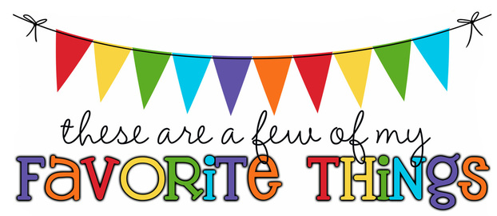
Monogram: SK Birthday: 7/1/1985 Shoe Size: 9.5 Food & Candy: Dark chocolate almonds, chocolate Color: Blue and Pink Drink: Coffee Flower: Daisies Scent (lotion): Butterfly (Bath & Body works) Starbucks Drink: Hot coffee with light cream Restaurants: Chili’s, Longhorn Sports Team: - Stores: Marshalls, Target Author: - Hobbies: Travelling, swimming Items I need for the classroom: -

