Slide 1
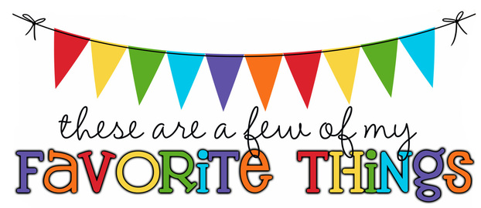
Monogram: SI on cup Birthday: June 10 Shoe Size: 5 Food & Candy: chicken Color: pink and purple Drink: coffee and Pepsi Flower: roses Scent (lotion): Lavender Starbucks Drink: mocha latte Restaurants: olive garden and chilis Stores: bath and body works and marshalls Hobbies: cook Items I need for the classroom: snacks

