Slide 1
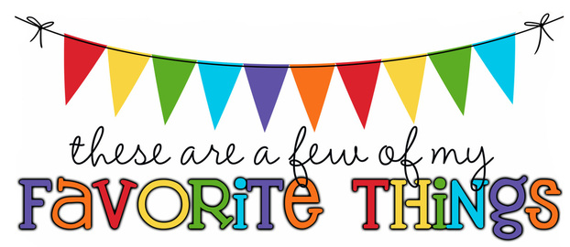
Monogram: JPF Birthday: February 14th Food & Candy: Reese’s cups, Albanese gummy bears, gluten-free snacks Color: blue Drink: Diet Coke, Polar seltzer water - unflavored Flower: Hydrangeas Scent (lotion): anything relaxing☺ Starbucks Drink: any Restaurants: any Sports Team: Rays, Lightning Stores: any (seriously, I am not picky) Items I need for the classroom: hummingbird feeder that attaches to the window, treasure box items, 100 – 200 piece puzzles, indoor games, Ticonderoga pencils

