Slide 1
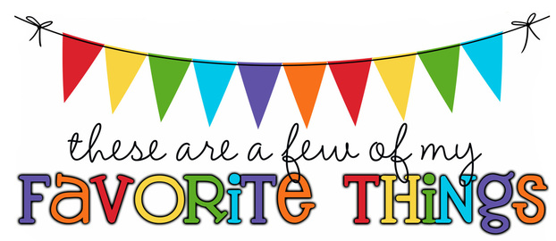
Monogram: ECM Birthday: July 7th Shoe Size: 9.5 Food & Candy: Reese’s, peanut M&M’s, sour candy, chocolate, baked chips Color: blue/green Drink: Coke zero, Dr. Pepper Flower: Lillies Scent (lotion): floral Starbucks Drink: Strawberry acai refresher, Vanilla bean Frappuccino Restaurants: Chili’s, Olive Garden, chick fil a Sports Team: Rays, lightning Stores: Marshall’s, Amazon Hobbies: Gym, nature trails, pool days! Items I need for the classroom: headphones, whiteboard markers, pencils, erasers, tape

