Slide 1
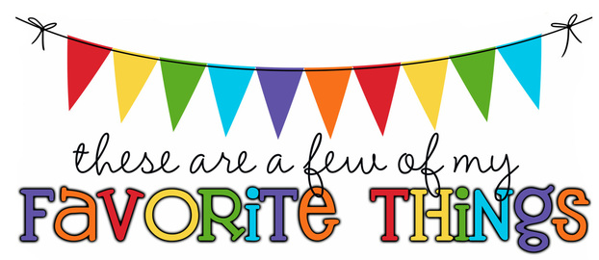
Monogram: KR Birthday: June 19 Food & Candy: Reese’s or Kit-Kats Color: Pink, Silver/Sparkles Drink: Coke Flower: Sunflower Scent (lotion): Coconut Starbucks Drink: Strawberry Acai Refresher Restaurants: Dunkin Donuts, Chick-fil-a, Starbucks Stores: ULTA, Target, Home Goods Hobbies: Journaling, Scrapbooking, Painting Items I need for the classroom: Treasure Box Items

