Slide 1
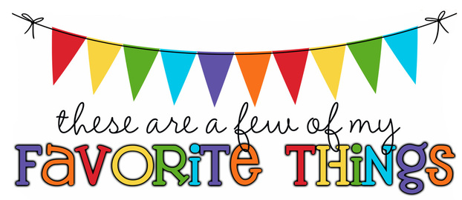
Monogram: HH Birthday: March 5th Shoe Size: 10 Food & Candy: Mexican food, Dark Chocolate Almonds, Color: purple and/or teal Drink: Diet Coke, Unsweetened iced tea Flower: Tulips Scent (lotion): None, I’m allergic to Bath and Body Works Starbucks Drink: Hot, White Chocolate Mocha Restaurants: Longhorn, Fish Bowl Kitchen, Carrabba’s Sports Team: Lightning Stores: Target, Hobby Lobby, Amazon Author: Nicholas Sparks Hobbies: Hand lettering, calligraphy, reading, movies Items I need for the classroom:

