Slide 1
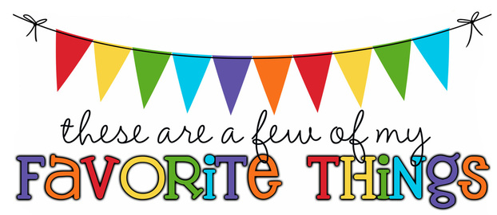
Monogram: EFP Birthday: March 3 Shoe Size: 10 Food & Candy: Flipz Milk Chocolate covered pretzels Color: Teal Drink: Water (MIO Berry Pomegrante)/coke Flower: Orchids Scent (lotion): nothing fruity Starbucks Drink: Carmel Macchiato Restaurants: Chilis, Carrabba's Sports Team: NOLA Saints, Miami Dolphins, Tampa bay Rays Stores: Target, Five Below, Amazon Author: Hobbies: beach, my kids, traveling Items I need for the classroom: Office Supplies

