Slide 1
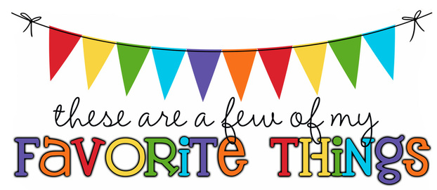
Monogram: KH Birthday: November 12 Shoe Size: 7 Food & Candy: Sushi/Seafood, chocolate (no nuts) Color: Red or Blue Drink: Gatorade and Coca-Cola Flower: Daises or carnations Scent (lotion): Apple or clean scents Starbucks Drink: Any Frappuccino Restaurants: Cheddar’s, Panera, Chick-Fil-A Sports Team: USF Stores: Target, Game Stop, Box Lunch Author: Marissa Meyer, Rick Riordan Hobbies: Video games, collecting Funko Pop! Figures Items I need for the classroom: Wireless doorbell, wireless microphone
Kaycie Howell

